Slide 1
WIP : Parkinson’s wearing-off Detection: Forecasting, App Design, and Behavior Feedback
Final Presentation
KANIKA GUPTA
Kyushu Institute of Technology Internship Student
1

Slide 2
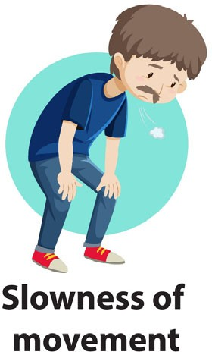
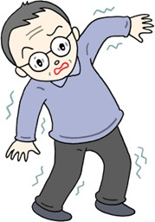
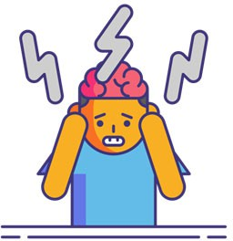
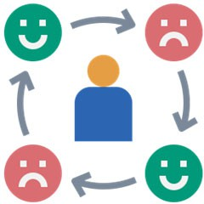
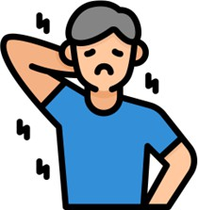


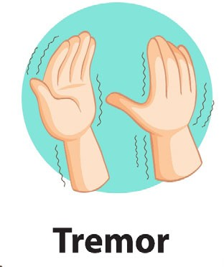
Parkinson’s Disease (PD)
Research Background
Parkinson’s Disease (PD)
PD is a slowly progressive disorder of the nervous system due to loss of dopamine-producing brain cells.
Motor Symptoms Non-Motor Symptoms
Symptoms and its severity vary for each patient
+
→
Affects daily life & Quality of Life (QoL)
Postural Instability
Mental Functions
Mood
(Bradykinesia)
Collaborate with clinicians for customized treatment
Muscle stiffness (Rigidity)
Sleep
J. Massano and K. P. Bhatia, ‘Clinical Approach to Parkinson’s Disease: Features, Diagnosis, and Principles of Management’, Cold Spring Harb Perspect Med, vol. 2, no. 6, Jun. 2012, doi: 10.1101/cshperspect.a008870.
S. Sveinbjornsdottir, ‘The clinical symptoms of Parkinson’s disease’, Journal of Neurochemistry, vol. 139, no. S1, pp. 318–324, 2016, doi: 10.1111/jnc.13691.
2

Slide 3





Wearing-Off Phenomenon (WO)
Research Background
Wearing-Off Phenomenon (WO)
Patients undergo Levodopa treatment (L-dopa) to alleviate the symptoms.
5. Over time,
#3 shortens causing discomfort
to the PD patient
1. PD patient experiences symptoms
3. PD patient are relieved of symptoms
4. Symptoms start
to re-appear before the next prescribed medicine intake (wearing-off)
2. Anti-PD medicine intake as prescribed
Wearing-off needs to be monitored & reported by PD patients to re- adjust the treatment plan.
A. Antonini et al., ‘Wearing-off scales in Parkinson’s disease: Critique and recommendations: Scales to Assess Wearing-Off in PD’, Mov. Disord., vol. 26, no. 12, pp. 2169–2175, Oct. 2011, doi: 10.1002/mds.23875.
D. Colombo et al., ‘The “Gender Factor” in Wearing-Off among Patients with Parkinson’s Disease: A Post Hoc Analysis of DEEP Study’, The Scientific World Journal, Jan. 20, 2015. https://www.hindawi.com/journals/tswj/2015/787451/
Victorino, John Noel, et al. "Understanding wearing-off symptoms in Parkinson’s disease patients using wrist-worn fitness tracker and a smartphone." Procedia Computer Science 196 (2022): 684-691.
3
Victorino, John Noel, et al. "Predicting wearing-off of Parkinson’s disease patients using a wrist-worn fitness tracker and a smartphone: A case study." Applied Sciences 11.16 (2021): 7354.

Slide 4
Research Objectives
Improve Existing Models Refine and re-evaluate previously developed ML models for higher prediction accuracy.
2. Expand Algorithm Scope Implement and compare additional machine learning and deep learning models.
3. Customized-Time Model Deployment Deploy the best-performing model on a server to enable real-time, customized wearing-off prediction.
4. Application Enhancement Improve the WoForecastProto app for intuitive visualization of prediction results.
5. Integrate Behavioral Feedback Designed and embedded post-prediction questions in FonLog to collect user responses and enhance future model performance.
4

Slide 5
Related Search
1. Victorino et al. (2021) Predicting Parkinson’s Wearing-Off Using Wearables
Used Garmin + FonLog data
Achieved up to 76.9% balanced accuracy
Personalized ML models for real-life prediction
[Applied Sciences, 2021]
2. Victorino et al. (2022) Understanding Wearing-Off Symptoms via Smart Devices
Analyzed sleep, steps, drug timing as key indicators
Showed feasibility of commercial trackers
[Procedia Computer Science, 2022]
5

Slide 6
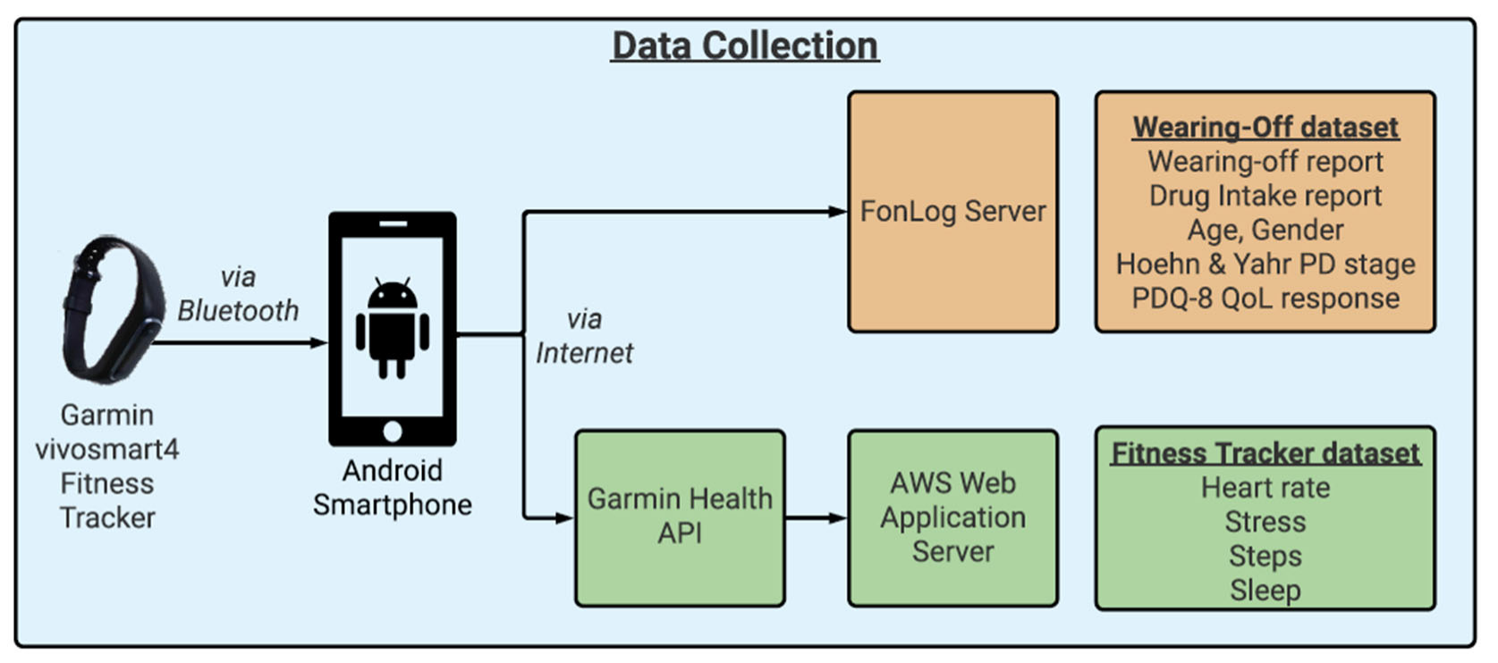
Previously Collected Data Process
Research Method
Data Collection Process
PD patients who are aware of wearing-off
PD participants were asked to contribute 30 days’ worth of data from 23rd February’21 to 24th March’21
Wear fitness tracker
Report wearing-off period and drug intake period using a smartphone app
Victorino, John Noel, et al. "Understanding wearing-off symptoms in Parkinson’s disease patients using wrist-worn fitness tracker and a smartphone." Procedia Computer Science 196 (2022): 684-691.
Victorino, John Noel, et al. "Predicting wearing-off of Parkinson’s disease patients using a wrist-worn fitness tracker and a smartphone: A case study." Applied Sciences 11.16 (2021): 7354.
6

Slide 7
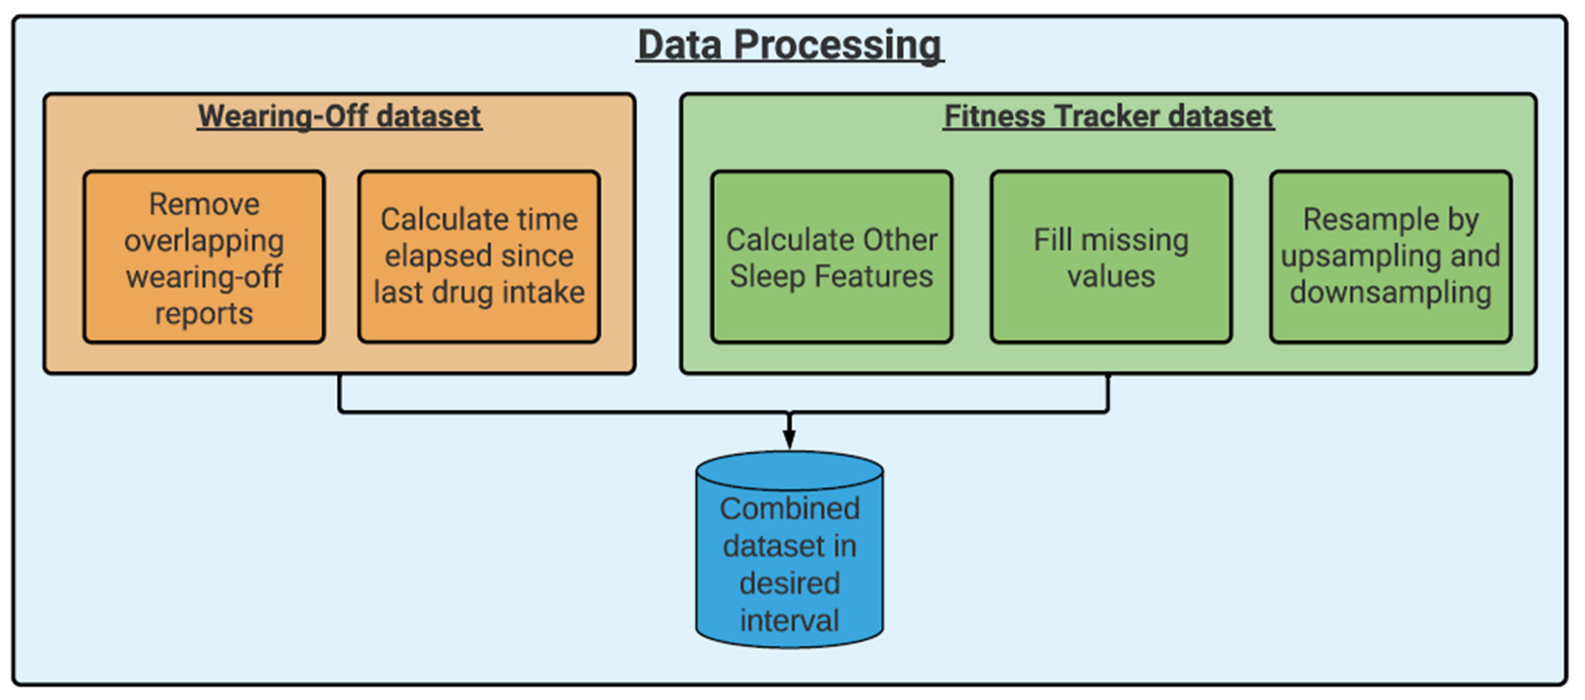
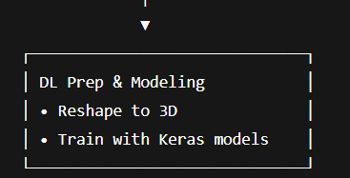
Data Processing for ML+DL
Research Method
Data Processing

Slide 8
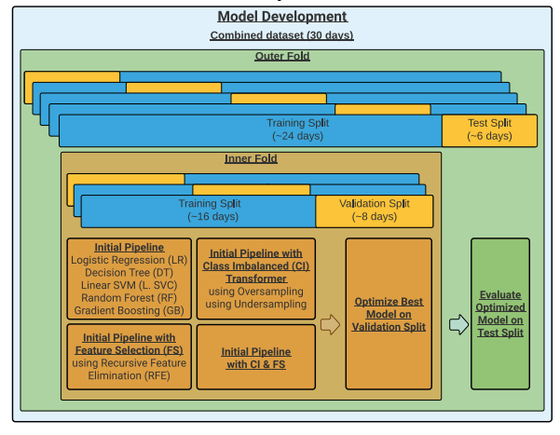
Model Development for ML
Research Method
Data Processing
+ LightGBM (LGBMC)

Slide 9
Model Development for DL
Research Method
Data Processing
Data Preparation
• Clean & select features
Feature Engineering
• Label shift, scaling
Input Reshaping
• MLP: 2D LSTM/CNN: 3D
Model Building
• MLP / LSTM / 1D CNN
Train & Validate
• Adam, BCE, val split
Evaluate Model
• Metrics, confusion matrix

Slide 10
Garmin vivosmart4 Datasets
Experiments
Garmin vivosmart4 Datasets
Data Type | Granularity | Description
Heart rate | 15-second interval | Beats per minute (bpm)
Steps | 15-minute interval | Cumulative count per interval (minimum: 0)
Stress score | 3-minute interval | Estimated stress score (0 – 100) 0 – 25: Resting state 26 – 50: Low stress 51 – 75: Medium stress 76 – 100: High stress -1: not enough data to detect stress -2: too much motion
Sleep classification & Sleep period | Per calendar date | Start and end time per sleep classification Light sleep Rapid eye movement (REM) sleep Deep sleep Awake
7
Garmin, ‘vívosmart 4 - Heart Rate Variability and Stress Level’, Heart Rate Variability and Stress Level. Oct. 2020. Accessed: Apr. 06, 2021. [Online]. Available: https://www8.garmin.com/manuals/webhelp/vivosmart4/EN-US/GUID-9282196F-D969-404D-B678-F48A13D8D0CB.html
10

Slide 11
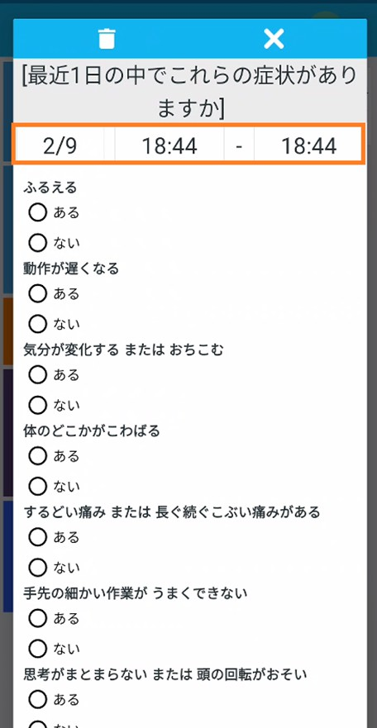
Smartphone Application Dataset
Experiments
Smartphone Application Dataset
Data collection tool to record experienced symptoms (using Japanese Wearing-Off Questionnaire or WoQ-9)
Tremors
Slowing down of movement
Change in mood / Depression
Rigidity of muscles
Sharp pain / Prolonged dull pain
Impairment of complex movement of hands & fingers
Difficulty integrating thoughts / slowing down of thought
Anxiety / Panic attacks
Muscle spasm
Drug intake and its effects were also part of WoQ-9
Age, Gender, Hoehn and Yahr PD Stage, PDQ-8 QoL response (one time)

Slide 12
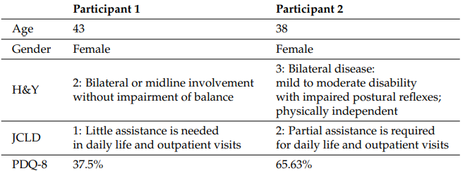
Participant Demographics
Experiments
12

Slide 13
Best hyperparameter configuration performance on the validation set among all ML models
Results and Discussion
Model Development
Participant1_15mins
Participant1_15secs
 | Balanced Accuracy | F1 Score | Precision
Initial Pipeline | 0.5680 | 0.4995 | 0.5908
Feature Selection | 0.5713 | 0.4438 | 0.6791
Class Imbalance | 0.5712 | 0.5325 | 0.5840
Feature Selection + Class Imbalance | 0.5714 | 0.4688 | 0.6104
 | Balanced Accuracy | F1 Score | Precision
Initial Pipeline | 0.5559 | 0.4852 | 0.5292
Feature Selection | 0.5683 | 0.4510 | 0.6133
Class Imbalance | 0.5700 | 0.5173 | 0.5395
Feature Selection + Class Imbalance | 0.5629 | 0.4346 | 0.6080
Metrics
FS+CI
Participant2_15mins
Participant2_15secs
 | Balanced Accuracy | F1 Score | Precision
Initial Pipeline | 0.6726 | 0.1128 | 0.0610
Feature Selection | 0.6794 | 0.1416 | 0.0832
Class Imbalance | 0.7351 | 0.1843 | 0.1393
Feature Selection + Class Imbalance | 0.7505 | 0.1583 | 0.0887
 | Balanced Accuracy | F1 Score | Precision
Initial Pipeline | 0.6843 | 0.0855 | 0.0449
Feature Selection | 0.7001 | 0.1086 | 0.0605
Class Imbalance | 0.7321 | 0.1019 | 0.0541
Feature Selection + Class Imbalance | 0.7529 | 0.1303 | 0.0725
13

Slide 14
Comparison of ML algorithms performance on the validation set using the FS+CI best pipeline
Results and Discussion
Model Development
Participant1_15secs
Participant1_15mins
 | Balanced Accuracy | F1 Score | Precision
LR | 0.5367 | 0.4074 | 0.6230
DT Classifier | 0.5595 | 0.4525 | 0.5970
Linear SVC | 0.5180 | 0.3821 | 0.5977
RF Classifier | 0.5287 | 0.4445 | 0.5332
GB Classifier | 0.5596 | 0.5130 | 0.5645
LGBMC | 0.5549 | 0.5066 | 0.5587
 | Balanced Accuracy | F1 Score | Precision
LR | 0.5294 | 0.3877 | 0.5642
DT Classifier | 0.5325 | 0.4545 | 0.5005
Linear SVC | 0.5253 | 0.4014 | 0.5547
RF Classifier | 0.5227 | 0.4430 | 0.4846
GB Classifier | 0.5365 | 0.4702 | 0.5045
LGBMC | 0.5587 | 0.5054 | 0.5267
Metrics
GBC
Participant2_15secs
Participant2_15mins
 | Balanced Accuracy | F1 Score | Precision
LR | 0.6291 | 0.0918 | 0.0486
DT Classifier | 0.7146 | 0.1342 | 0.0742
Linear SVC | 0.6328 | 0.1022 | 0.0552
RF Classifier | 0.7348 | 0.1454 | 0.0809
GB Classifier | 0.7348 | 0.1286 | 0.0693
LGBMC | 0.7151 | 0.1255 | 0.0681
 | Balanced Accuracy | F1 Score | Precision
LR | 0.6385 | 0.0760 | 0.0398
DT Classifier | 0.7228 | 0.1074 | 0.0584
Linear SVC | 0.6480 | 0.0772 | 0.0404
RF Classifier | 0.7109 | 0.1094 | 0.0598
GB Classifier | 0.6926 | 0.0911 | 0.0482
LGBMC | 0.7326 | 0.1496 | 0.1406
14

Slide 15
Comparison of DL algorithms performance on the test set using keras except for MLP
Results and Discussion
Model Development
Participant1_15mins
Participant1_15secs
 | F1 score | Recall | Precision
1D CNN | 0.6955 | 0.6960 | 0.6965
LSTM | 0.7413 | 0.7415 | 0.7440
MLP | 0.6465 | 0.6465 | 0.6465
 | F1 score | Recall | Precision
1D CNN | 0.8045 | 0.8020 | 0.8131
LSTM | 0.9222 | 0.9224 | 0.9220
MLP | 0.7800 | 0.7782 | 0.7852
Metrics
LSTM
Participant2_15mins
Participant2_15secs
 | F1 score | Recall | Precision
1D CNN | 0.6723 | 0.7004 | 0.6521
LSTM | 0.6271 | 0.5821 | 0.8425
MLP | 0.4911 | 0.5000 | 0.4826
 | F1 score | Recall | Precision
1D CNN | 0.5936 | 0.5567 | 0.8792
LSTM | 0.6946 | 0.6320 | 0.8935
MLP | 0.6832 | 0.5624 | 0.8443
15

Slide 16
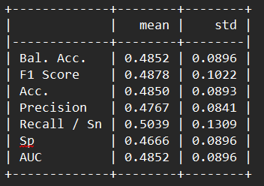
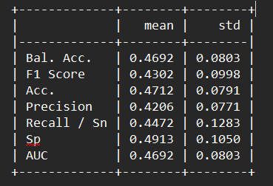
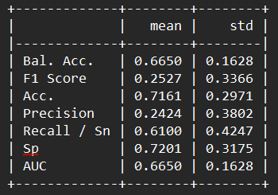
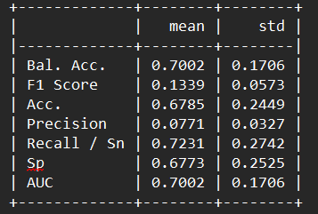
Average performance of best ML model on the test set using the FS+CI best pipeline + GB best ML model using final Pipeline
Results and Discussion
Model Development
Participant1_15mins
Participant1_15secs
Metrics
Participant2_15mins
Participant2_15secs

Slide 17
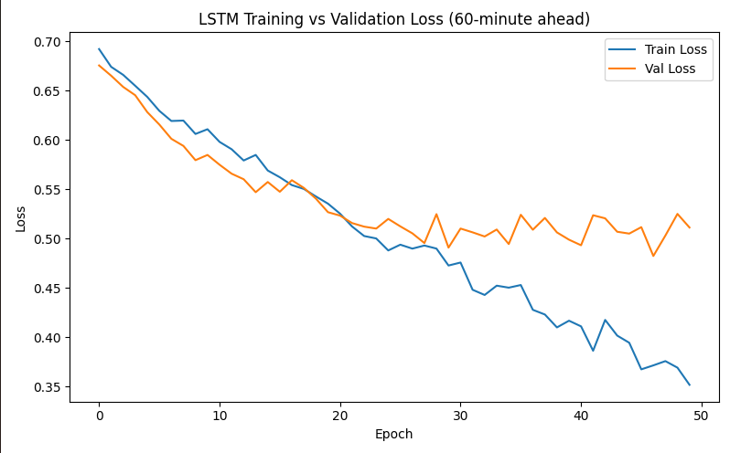
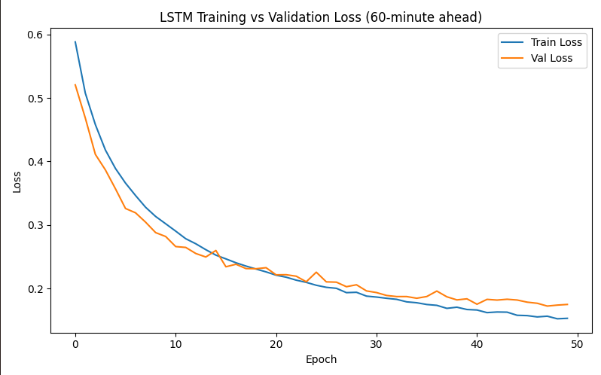
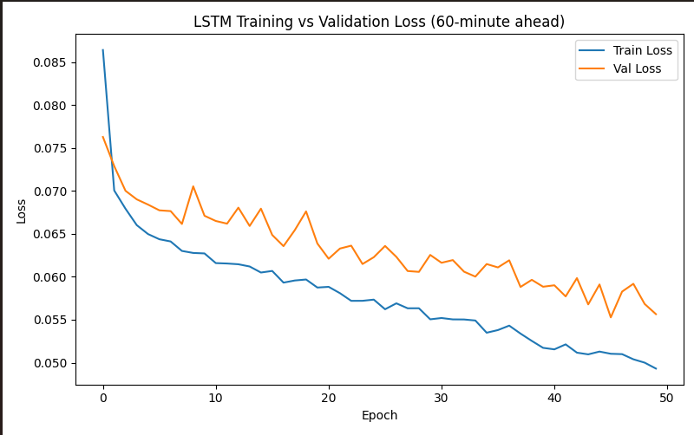
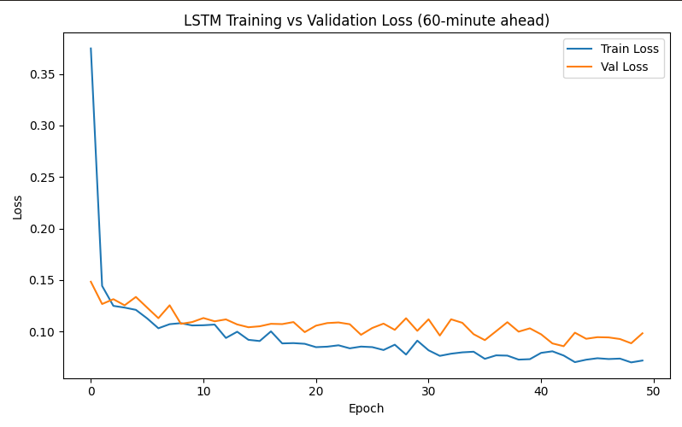
Training vs Validation curves for best DL model
Results and Discussion
Model Development
Participant1_15mins
Participant1_15secs
Metrics
Participant2_15mins
Participant2_15secs

Slide 18
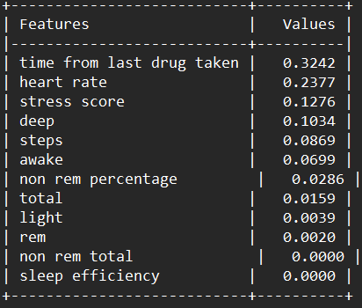
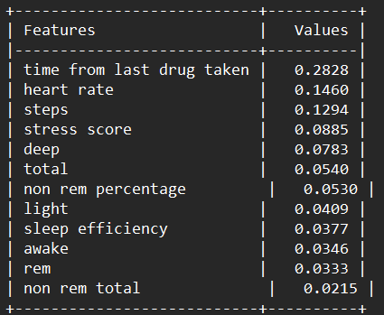
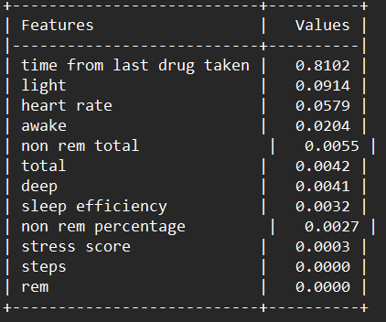
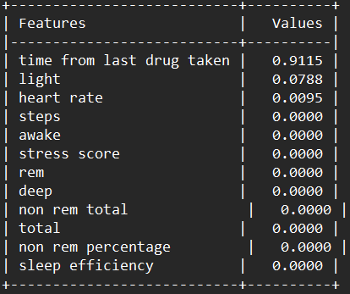
Permutation feature importance for the FS+CI best pipeline + GB best model using final pipeline
Results and Discussion
Participant1_15mins
Participant1_15secs
Participant2_15mins
Participant2_15secs
18

Slide 19
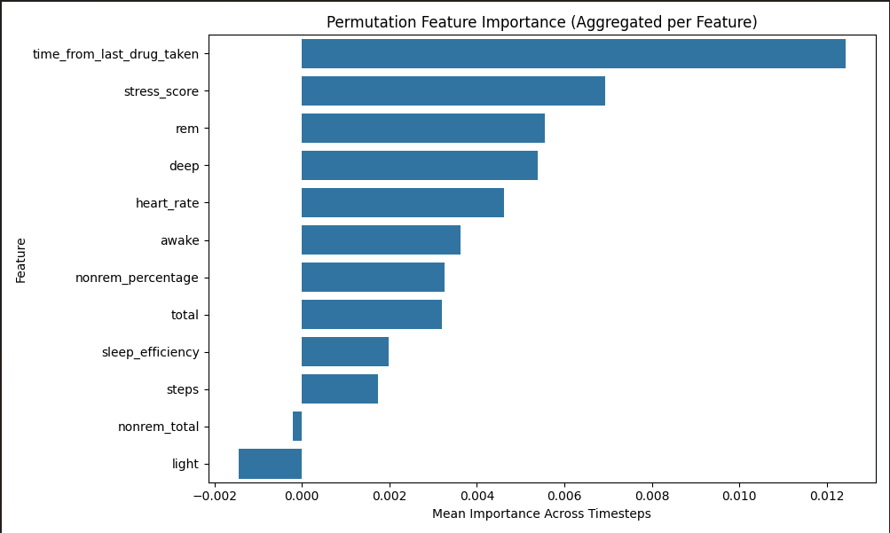
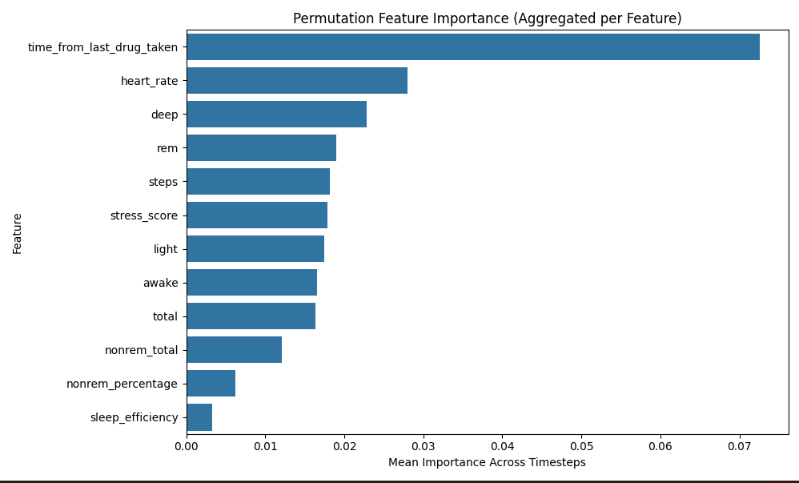
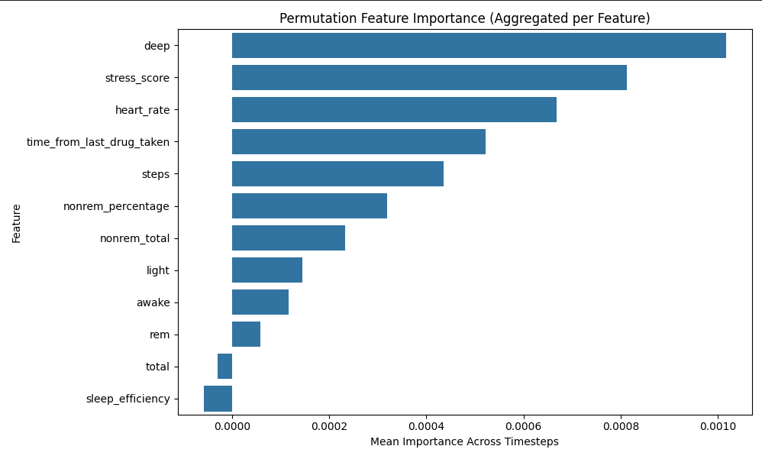
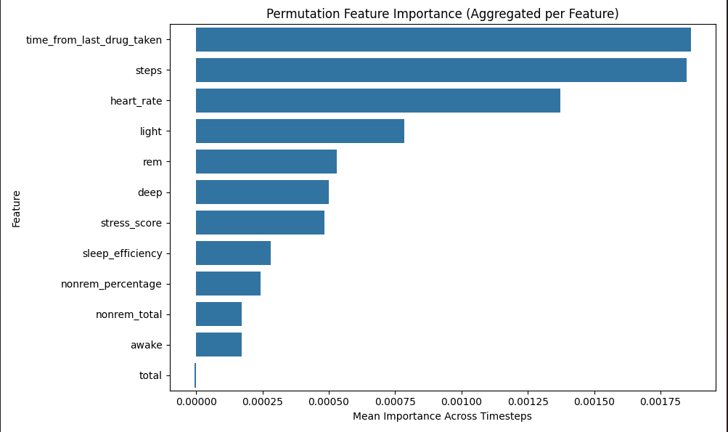
Permutation feature importance by the best DL model
Results and Discussion
Participant1_15mins
Participant1_15secs
Participant2_15mins
Participant2_15secs
19

Slide 20
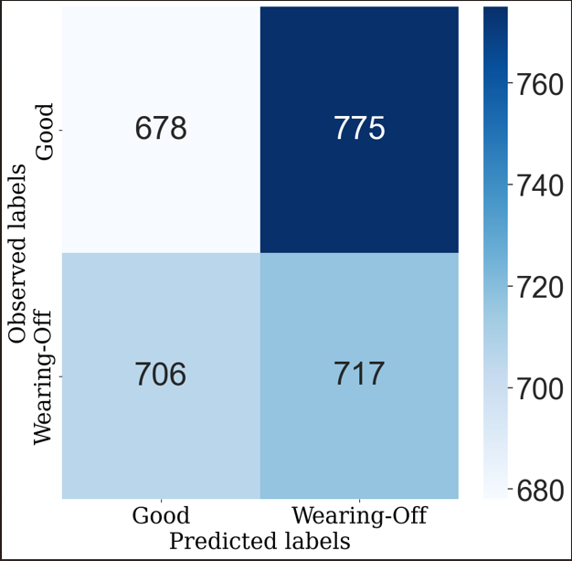
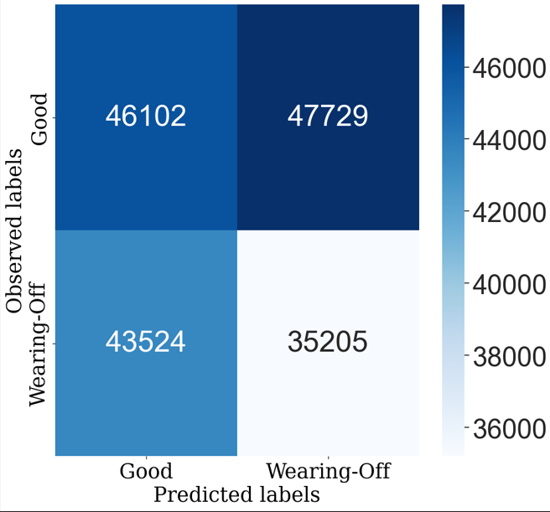
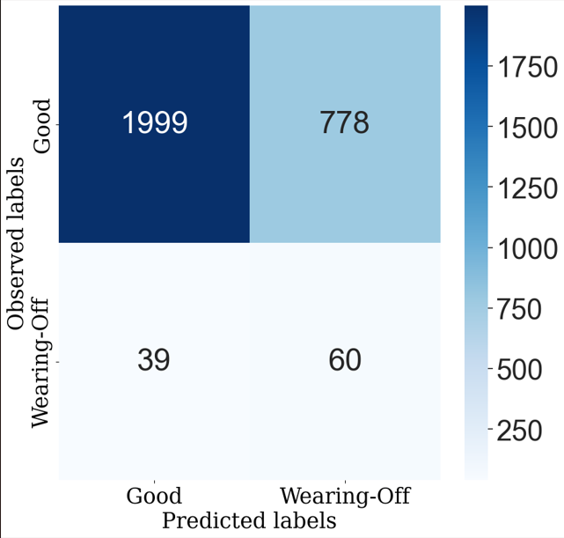
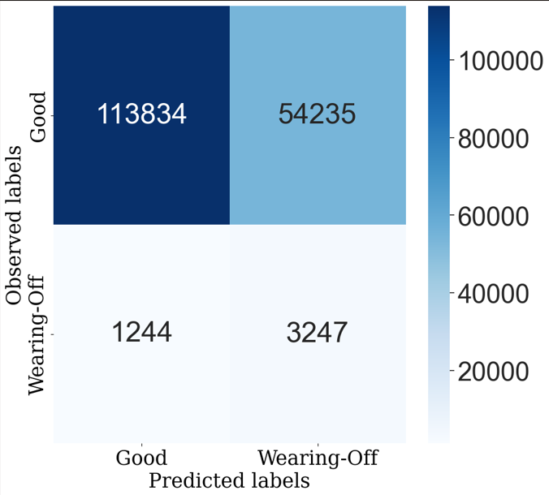
CONFUSION MATRIXs by best ML case
Results and Discussion
Participant1_15mins
Participant1_15secs
Participant2_15mins
Participant2_15secs
20

Slide 21
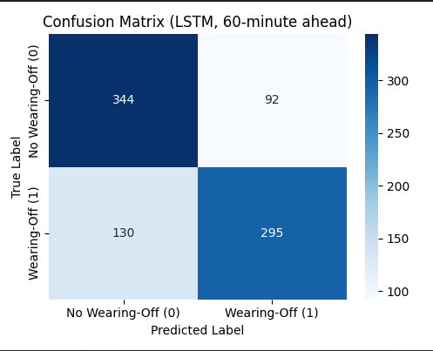
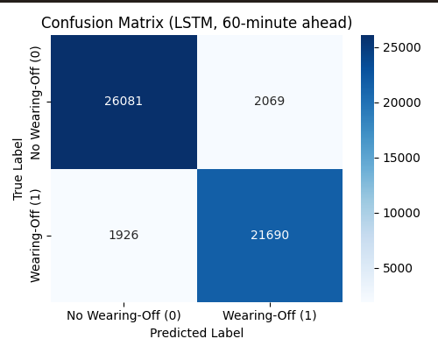
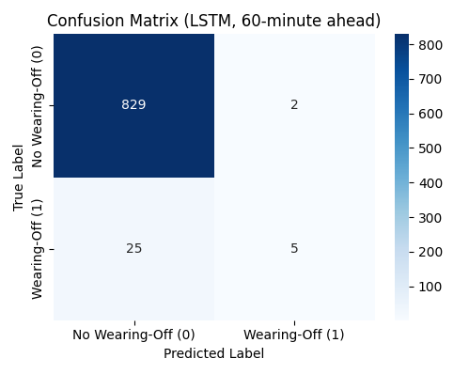
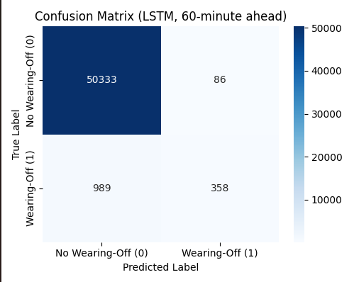
CONFUSION MATRIXs by best DL case
Results and Discussion
Participant1_15mins
Participant1_15secs
Participant2_15mins
Participant2_15secs
21

Slide 22
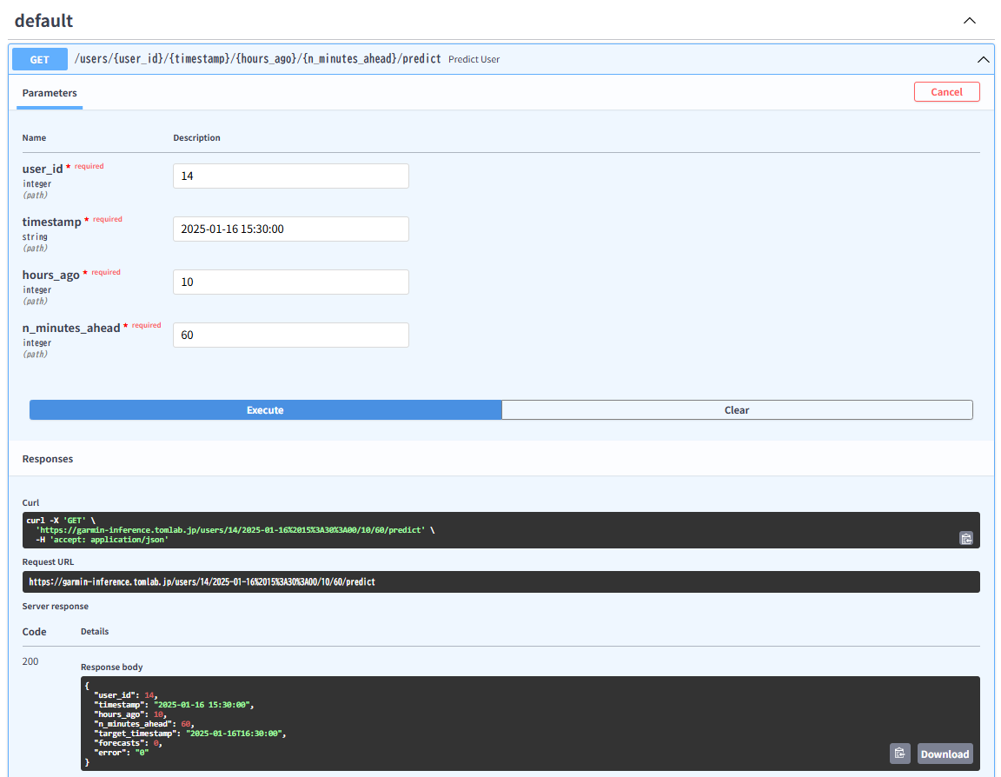
Cutomized-Time Deployment on Garmin server for Wearing-Off Prediction
Results and Discussion
22

Slide 23
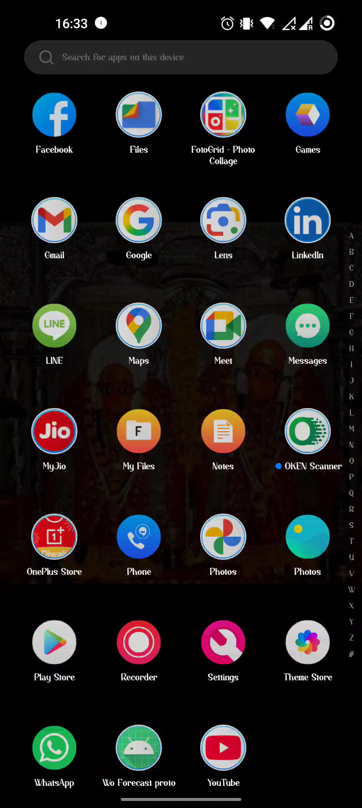
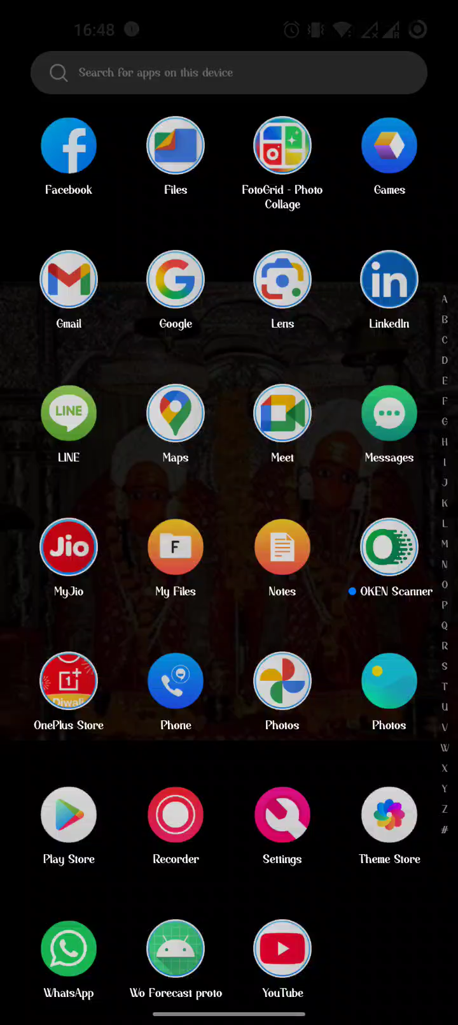
Application Enhancement-WoForecastProto (Intervention App) Demo
Results and Discussion
23
On-Off Case
Error Case

Slide 24
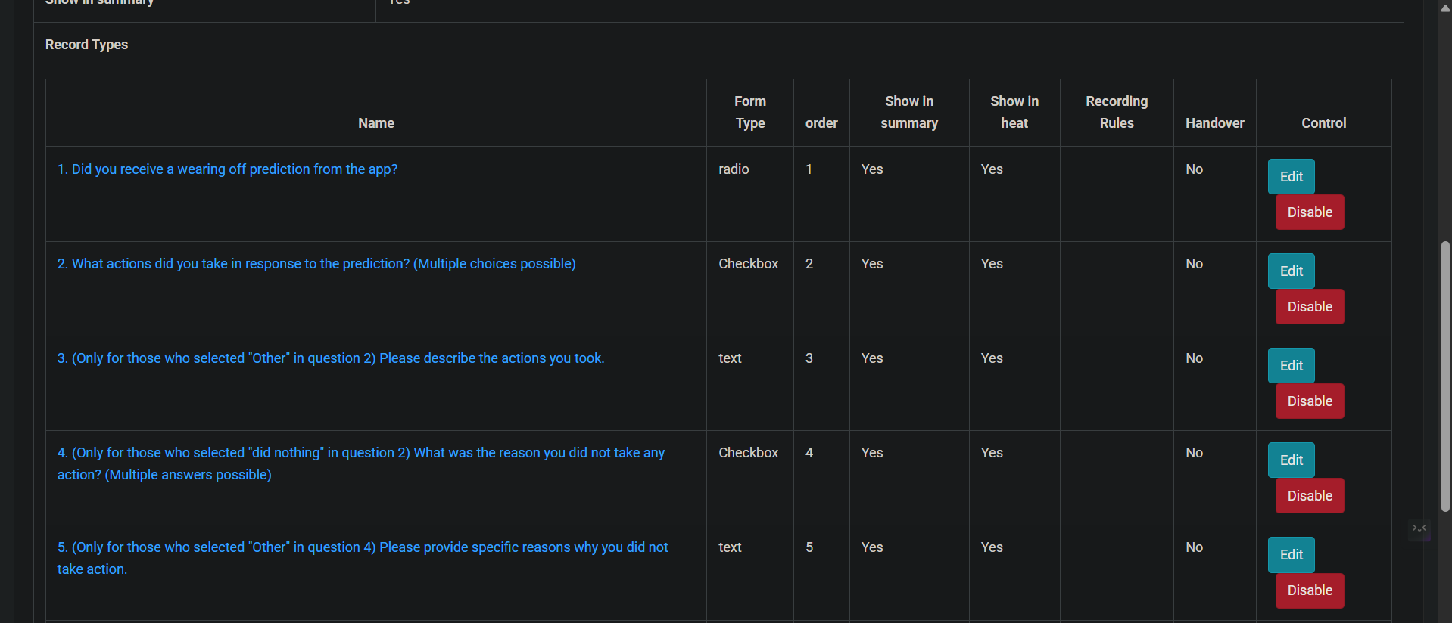
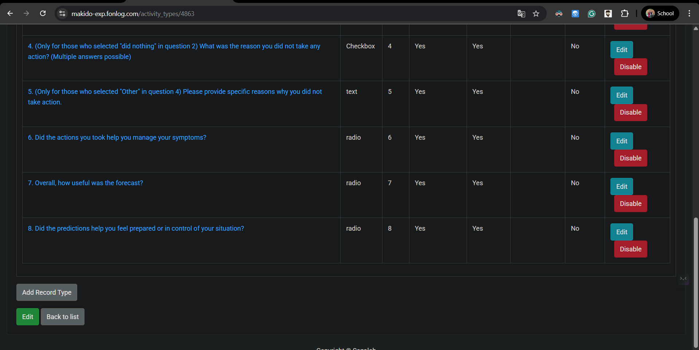
Post-Prediction Behavioral Questionnaire
Results and Discussion
24

Slide 25
Summary
Best Models Identified GBC was the top ML model; LSTM outperformed all and was selected as the overall best.
Algorithm Expansion Evaluated and compared various ML and DL models to enhance prediction accuracy.
Customized Real-Time Deployment Deployed the LSTM model on a server for instant predictions with user-defined forecast intervals (e.g., 15–60 mins).
App Enhancement Improved the WoForecastProto app with intuitive, real-time prediction visualization.
Behavioral Feedback Integration Embedded follow-up questions in FonLog to collect patient input and continuously improve model performance.
25

Slide 26
Research Future Work
Future Prospectives
Future Work
Analyzing the results with more experiments with the support of PD patients

Slide 27
THANK YOU
27

Slide 28








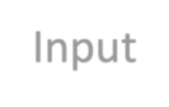

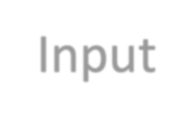


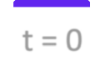




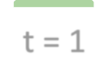
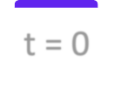
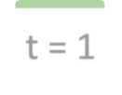










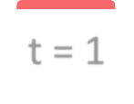









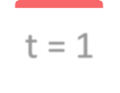




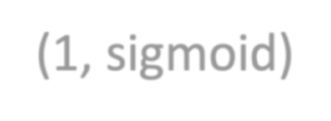









Models Considered
Models Considered
Current Time Models:
Input: current time step (t = 0)
Output: next hour (t = 1)
𝑦_{t+1} = 𝑓 (𝑋_{t}, 𝑦_{t}), 𝑋_{t} = {𝑥₁,𝑥₂, … ,𝑥₁₄}
Baseline Model
Linear Model
Single time-step Dense Model
Input t = 0
Label t = 1
Input t 0
Label t = 1
Input t 0
Label t = 1
t = 1
Dense
t = 1
Dense
t = 1
Dense
Prediction
(1, sigmoid)
Prediction
Dense
(6 ReL )
(6 ReL )
Prediction
4,
u
Note:
4,
u
Shown as hourly interval
Data is in every 15-minute interval (1 hour = 4 rows)
(1, sigmoid)

Slide 29

































Models Considered
Models Considered
Day Models:
Input: from the last day (t = 0…24)
Output: next hour (t = 1)
Multi time-step Dense Model
Input
Label
t = 0
…
t 24
t = 25
Flatten
Dense
t = 25
Dense
Dense
(1 ReL )
(1 ReL )
Prediction
6,
u
6,
u
(1, sigmoid)

Slide 30
CNN Model
CNN Model
Input
Labels
…
t = 25
t = 26
t = 27
t = 0
t = 24
Conv1D ((16,24), ReLu)
Dense
(16, ReLu), (1, sigmoid)
t = 26
t = 25
t = 27
Predictions

Slide 31




































LSTM Model
Input
t 0 t = 1 = 2
t
LSTM
LSTM
LSTM
t = 1
t = 2
t = 3
Prediction
t = 1
t = 2
t = 3
Label

Slide 32





Participants’ Demographics
Participants’ Demographics
Participants H&Y Score JCLD PDQ-8
4
6
Mean Age
57.1 yrs. old
(𝜎 = 15.059)
2.8
(𝜎 = 0.632)
2 = bilateral involvement without impairment of balance,
1.7
(𝜎 = 0.483)
1 = Little assistance
2 = Partial assistance
42.50%
(𝜎 = 0.192)
Higher score means worse QoL

Slide 33
Can a wrist-worn fitness tracker datasets be used to forecast wearing-off in the next hour?
Can a wrist-worn fitness tracker datasets be used to forecast wearing-off in the next hour?
Current Time Models AUC Performance across 10 participants
Current Time Models
Single time-step Dense model
Balanced Accuracy: 79.05% ± 7.09%
AUC: 69.14% ± 10.60%
100.00%
90.00%
80.00%
70.00%
60.00%
50.00%
40.00%
30.00%
20.00%
10.00%
0.00%
AUC Score
Baseline
Linear
Single time-step Dense Model

Slide 34
Can a wrist-worn fitness tracker datasets be used to forecast wearing-off in the next hour?
Can a wrist-worn fitness tracker datasets be used to forecast wearing-off in the next hour?
1-day Models AUC Performance across 10 participants
1-day Models
CNN model
Balanced Accuracy: 80.64% ± 10.36%
AUC: 60.52% ± 30.26%
100.00%
90.00%
80.00%
70.00%
60.00%
50.00%
40.00%
30.00%
20.00%
10.00%
0.00%
AUC Score
Multi time-step Dense Model CNN LSTM

Slide 35


Which among the six deep learning architectures performed well in forecasting wearing-off in the next hour?
Which among the six deep learning architectures performed well in forecasting wearing-off in the next hour?
Architectures | Bal. Acc. | AUC | Precision | Recall
Baseline | 79.05% ± 07.09% | 50.20% ± 05.68% | 07.81% ± 10.16% | 07.59% ± 09.66%
Linear | 79.05% ± 07.09% | 64.71% ± 16.25% | 05.08% ± 06.34% | 28.73% ± 33.58%
 | 79.05% ± 07.09% |  | 06.25% ± 13.50% | 06.15% ± 15.83%
LSTM | 50.00% ± 00.00% | 57.83% ± 17.13% | 03.20% ± 05.17% | 08.10% ± 14.78%
Single time-step
Dense
69.14% ± 10.60%
^{Multi time-step} 80.64% ± 10.36% 60.23% ± 28.33% 18.55% ± 32.29% 36.17% ± 42.24%
Dense
CNN 80.64% ± 10.36% 60.52% ± 30.26% 18.61% ± 31.98% 25.06% ± 39.10%
Multi time-step Dense & CNN had high scores in Bal. Acc. Precision, & Recall
Single time-step Dense had the highest AUC

Slide 36

Discussion
Discussion
Multi time-step Dense & CNN models still had a recall score lower than 50%
Low recall score = Missed wearing-off forecast
69
0
5
0
AUC metric had been considered to balance true positive rate (recall) & false positive rate

Slide 37









Discussion
Discussion
Need to adjust the threshold value for the forecast probability

Slide 38

Related Works: Detecting Wearing-Off
Related Works: Detecting Wearing-Off
Study | Goal | Data Used | Result
Hoff et al, 2004 | Detection: wearing-off, dyskinesia | Accelerometer | Sensitivity: 60% - 71% Specificity: 66% - 76%
Keijsers, 2006 | Detection: wearing-off, bradykinesia, hypokinesia, tremor | Accelerometer | Sensitivity: 97% Specificity: 97%
Hssayeni, 2019 | Detection: wearing-off | Accelerometer, Gyroscope | Accuracy: 90.5% Sensitivity: 94.2% Specificity: 85.4%
Aich, 2020 | Detection: Wearing-off, Gait features | Accelerometer | Random Forest: 96.72% accuracy
Focused on using motion data
Generalized models for the participants (except for Hssayeni, 2019)
Detection of wearing-off rather than prediction
J. I. Hoff, V. van der Meer, and J. J. van Hilten, ‘Accuracy of Objective Ambulatory Accelerometry in Detecting Motor Complications in Patients With Parkinson Disease’, Clinical Neuropharmacology, vol. 27, no. 2, pp. 53–57, Apr. 2004.
N. L. W. Keijsers, M. W. I. M. Horstink, and S. C. A. M. Gielen, ‘Ambulatory motor assessment in Parkinson’s disease’, Movement Disorders, vol. 21, no. 1, pp. 34–44, 2006, doi: https://doi.org/10.1002/mds.20633.
M. D. Hssayeni, M. A. Burack, J. Jimenez-Shahed, and B. Ghoraani, ‘Assessment of response to medication in individuals with Parkinson’s disease’, Med Eng Phys, vol. 67, pp. 33–43, May 2019, doi: 10.1016/j.medengphy.2019.03.002.
S. Aich et al., ‘A Supervised Machine Learning Approach to Detect the On/Off State in Parkinson’s Disease Using Wearable Based Gait Signals’, Diagnostics, vol. 10, no. 6, p. 421, Jun. 2020, doi: 10.3390/diagnostics10060421.
25

Slide 39



Related Works: Non-Motor Aspect of PD & WO
Related Works: Non-Motor Aspect of PD & WO
PD patients’ blood pressure & heart rate were studied during WO.
There’s statistical difference in blood pressure change
Heart Rate
Highly sensitive to the effects of stress with clinical evidence
Worsen tremors, freezing of gait (FoG) and dyskinesia
Stress
Rapid eye movement sleep behavior disorder, sleep disturbances affect PD patients.
Sleep &
Sleep Stages
V. Pursiainen, J. T. Korpelainen, T. H. Haapaniemi, K. A. Sotaniemi, and V. V. Myllylä, ‘Blood pressure and heart rate in parkinsonian patients with and without wearing-off’, European Journal of Neurology, vol. 14, no. 4, pp. 373–378, 2007, doi: 10.1111/j.1468-1331.2007.01672.x.
M. Salsone et al., ‘Cardiac sympathetic index identifies patients with Parkinson’s disease and REM behavior disorder.’, Parkinsonism & related disorders, 2016, doi: 10.1016/j.parkreldis.2016.03.004.
J.-E. Lee, J.-S. Kim, D.-W. Ryu, Y.-S. Oh, I. R. Yoo, and K.-S. Lee, ‘Cardiac Sympathetic Denervation Can Predict the Wearing-off Phenomenon in Patients with Parkinson Disease’, J Nucl Med, vol. 59, no. 11, pp. 1728–1733, Nov. 2018, doi: 10.2967/jnumed.118.208686.
A. van der Heide, M. J. Meinders, A. E. M. Speckens, T. F. Peerbolte, B. R. Bloem, and R. C. Helmich, ‘Stress and Mindfulness in Parkinson’s Disease: Clinical Effects and Potential Underlying Mechanisms’, Movement Disorders, vol. 36, no. 1, pp. 64–70, 2021, doi: 10.1002/mds.28345.
24

Slide 40

Sleep Features

Slide 41

Conclusion
Conclusion
Can wrist-worn fitness tracker datasets be used to forecast wearing-off in the next hour?
YES, forecasting wearing-off using commercial wrist-worn fitness tracker datasets was feasible.
With current time data
With 1-day’s worth of data
Which among the DL architectures performed well in forecasting wearing-off in the next hour?
Single time-step Dense
Multi time-step Dense
CNN
Single time-step Dense
Multi time-step Dense
CNN
Highest AUC: 69.14% ± 10.60%
Highest balanced accuracy: 80.64% ± 10.36%
Detecting & forecasting earing-off was feasible within a certain limit, even with only commercial fitness tracker features.
Detection & Forecasting models can be used in PD management

Slide 42



Current Landscape in Detecting PD symptoms or wearing-off
Current Landscape in Detecting PD symptoms or wearing-off
In-Clinic Data Collection
Motor Aspect
Keijsers, 2006
Jeon, 2017
Sama, 2017
Aich, 2018 & 2020
Steinmetzer, 2019
Hssayeni, 2019
Non-Motor Aspect
Pursiainen, 2007
Salsone, 2016
Lee, 2018
van der Heide, 2021
UPDRS
MDS-UPDRS
& other clinical research
Subjective Assessment
Objective Assessment
Parkinson’s Disease Diary
Griffiths, 2012,
Farzanehfar, 2018 & other clinical studies that use Parkinson’s Kinetigraph (PKG)
Victorino, 2021: Detection of Wearing-off
Current Study Forecasting Wearing-off
WoQ
Continuous Home Data Collection
5

Slide 43
Executive Summary
Executive Summary
Can wrist-worn fitness tracker datasets be used to forecast wearing-off in the next hour?
YES, forecasting wearing-off using commercial wrist-worn fitness tracker datasets was feasible.
With current time data
With 1-day’s worth of data
Which among the DL architectures performed well in forecasting wearing-off in the next hour?
Multi time-step Dense
CNN
Single time-step Dense
Multi time-step Dense
CNN
Single time-step Dense
Highest balanced accuracy: 80.64% ± 10.36%
Highest AUC: 69.14% ± 10.60%
Forecasting wearing-off was feasible within a certain limit, even with only commercial fitness tracker features.
Forecasting models can be used in PD management
4

Slide 44

Garmin vivosmart4
Chosen due to sleek, lightweight; waterproof
Weight: 16.5g – 17.1g
Dimensions: 15 x 10.5 x 197 mm
Communicates with Garmin Health API via Garmin Connect smartphone app

Slide 45
FonLog Smartphone Application Dataset
FonLog Smartphone Application Dataset
Data | Description
WoQ-9 | Symptoms onset and drug intake time
Basic Information | Age, Gender
Hoehn and Yahr Scale (H&Y), Japan Ministry of Health, Labor, and Welfare’s classification of living dysfunction (JCLD) | Participant’s PD stage
Parkinson’s Disease Questionnaire (PDQ-8) | Participant’s QoL measurement specific to PD 0 – 100%, with 100% showing worst QoL

Slide 46
Model Development
Results and Discussion
Model Development
Developed personalized models
Data split
Training Set: 60%
Validation & Test Sets: 20%
Features Used
x₁ : Heartrate (HR)
x₂ : Number of steps (Step)
x₃ : Stress score (Stress)
x₄ : Awake duration (Awake)
x₅ : Deep sleep duration (Deep) x₆ : Light sleep duration (Light) x₇ : REM sleep duration (REM)
x₈ : Total non-REM sleep duration (NonREMTotal)
x₉ : Total sleep duration (Total)
x₁₀ : Time non-REM sleep percentage (NonREMPercentage)
x₁₁: Sleep efficiency (SleepEfficiency)
Metrics
Balanced Accuracy
AUC
Other metrics:
Accuracy, F1 Score, Precision, Recall
x₁₂ : Day of the week (TimestampDayofWeek)
x₁₃ : Sine value of Hour of the day (TimestampHourSin)
x₁₄ : Cosine value of hour of the day (TimestampHourCos)

Slide 47
Results and Discussion
Model Development
Metrics

